Slide 1
LOD (Level of Detail)
Terrain rendering

Slide 2

Level of Detail
Basic idea is that you render lower resolution models are larger distances from the camera
Sort of like mipmapping in textures

Slide 3
Basic implementation
Check the distance from the camera
Choose a different model based on distance

Slide 4
Terrain rendering
Same sort of problem:
REALLY large number of triangles and most of them are REALLY far away.
Like: does that mountain in the distance REALLY have to be drawn with every single triangle – just like when you are standing on it?
The big issue here is that it’s often one large mesh, or several really large meshes.
And you are really close to them and at a very shallow angle.

Slide 5
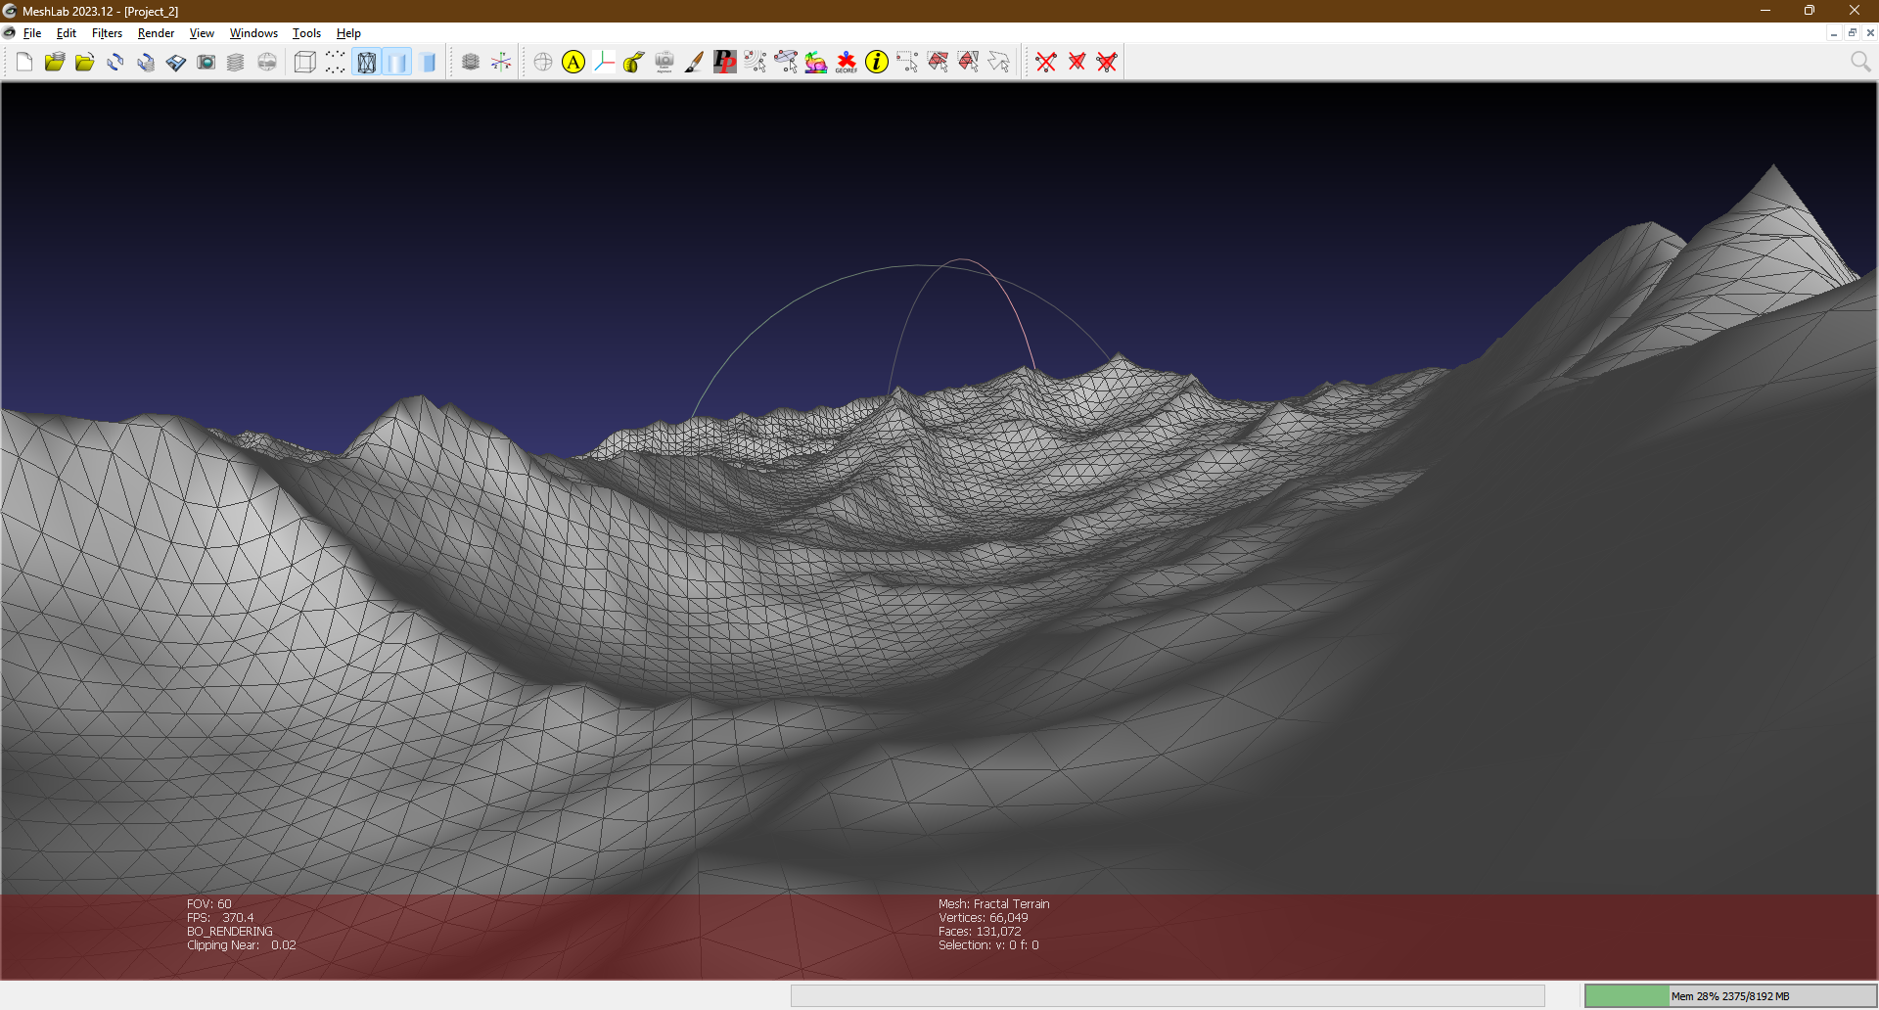
This is just the meshlab terrain (i.e. not that big) and doesn’t go that far into the distance, but you can see that most of the triangles are really away.

Slide 6
Terrain rendering
How about “tessellation”?
That’s for generating triangles, not taking them away
However, if you combine a flat mesh with a height map terrain, then YES, this is EXACTLY the sort of thing you can do
The “catch” is that you may have to have a really large texture, but that’s not much of an issue nowadays.

Slide 7
A couple other solutions:
GeoMipMapping:
Here you have tiles of terrains
You do the same sort of straight-forward LOD distance calculation
BUT: you have something that handles the edges between the tiles
It’s adjusts the triangles (combine or split) to match the resolution of the adjacent tile.
Original paper: https://en.wikipedia.org/wiki/Geomipmapping
https://wwhttps://www.flipcode.com/archives/article_geomipmaps.pdfhttps://www.flipcode.com/archives/article_geomipmaps.pdfw.flipcode.com/archives/article_geomipmaps.pdf

Slide 8
ROAM
https://en.wikipedia.org/wiki/ROAM
Dynamically generated the terrain per frame.
It combined/split triangles depending on distance from the camera. i.e. the terrain was always changing.
In “Treadmaks” (2000) game, the terrain was completely dynamic because it was being rendered realtime – on the CPU
Keep in mind that a computer at that time had these specs:
The typical PC in 2000 was gimping along on a 450MHz Pentium II with PC-100 SDRAM, and at best an 8GB ATA-33 (UDMA) hard disk drive running Windoze 98.

